Slide 1

BROWSER EXTENTION FOR REAL TIME PRIVACY PROTECTION
A brief guide to building a privacy extention

Slide 2

INTRODUCTION
REAL TIME PRIVACY PROTECTION IS A SYSTEM OR TOOL THAT ACTIVELY MONITERS AND BLOCKS PRIVACY THREATS WHILE YOU BROWSE THE INTERNET..IT INSTANTLY WORKS TO PREVENT TRACKERS,MALICIOUS WEBSITES FROM ACCESSING YOUR PERSONAL DATA,BROWSING HISTORY,LOCATION.

Slide 3

DISADVANTAGES OF USING UNSAFE WEBSITES:
DATA BREACH
VIRUSES ATTACKS
UNAUTHORIZED ACCESS
PHISHING SCAMS
IDENTITY THEFT
BATTERY DRAIN
FINANCIAL LOSS
POOR PERFORMANCE

Slide 4

Key featurers
Trackers blocking
Ad blocking
Encryption
Fingerprinting protection
Cookie management
Real time alerts

Slide 5



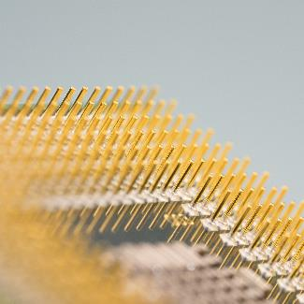

FEATURES
WEBSITE TRACKING
SEARCH HISTORY MONITORING
REAL TIME NOTIFICATION
SECUTITY
COSTOMIZABLE KEY
USER CAN CREATE CUSTOME CATEGORIES FOR WEBSITES
TRACK WEBSITESVISITED,INCLUDINGTIMESTAMPS,URL,PAGETITLES
LOG SEARCH QUERIES ENTRED INTO SEARCH ENGINES
NOTIFY USERS WHEN THET VISIT SITES MARKED AS DISTRACTIONS OR RESTRICTED
SECURE DATA WITH ENCRYPTION

Slide 6

Simple,intuitive dashboard
Color coded threat levels(red,grEEn)
Detailed reports and analytics
Constomizable notification
USER ITERFACE

Slide 7

Marketing strategry:
SOCIAL MEDIA COMPANIES
INFLUNCER PARTNERSHIP
CONTENT MARKETING
PAID ADVETISEMENT

